Slide 1


Content-Aware Click Modeling
Hongning Wang¹, ChengXiang Zhai¹, Anlei Dong² and Yi Chang²
¹Department of Computer Science
University of Illinois at Urbana-Champaign
Urbana IL, 61801 USA
{wang296,czhai}@illinois.edu
²Yahoo! Labs
701 First Avenue, Sunnyvale, CA 94089
{anlei,yichang}@yahoo-inc.com

Slide 2
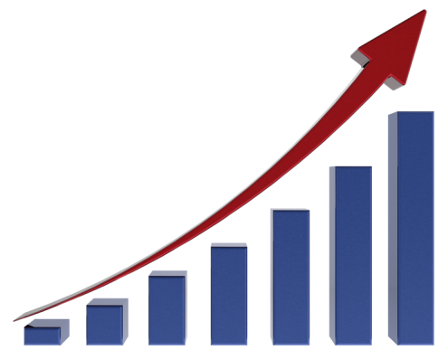
User Clicks: An Important Repository of Implicit Relevance Feedback
Large volume ^{[comScore qSearchTM]}
  Google: 406M queries/day
  Bing: 94M queries/day
  Yahoo!: 84M queries/day
Informative
  Signals for influencing ranking ^{[Agichtein et al. SIGIR’06]}
  Proxy of relevance ^{[Joachims et al. SIGIR’05]}
+5%/month
Notes:
User clicks on search engine result page provide rich and valuable feedback information about the relevance quality of search engine returned documents.

Slide 3
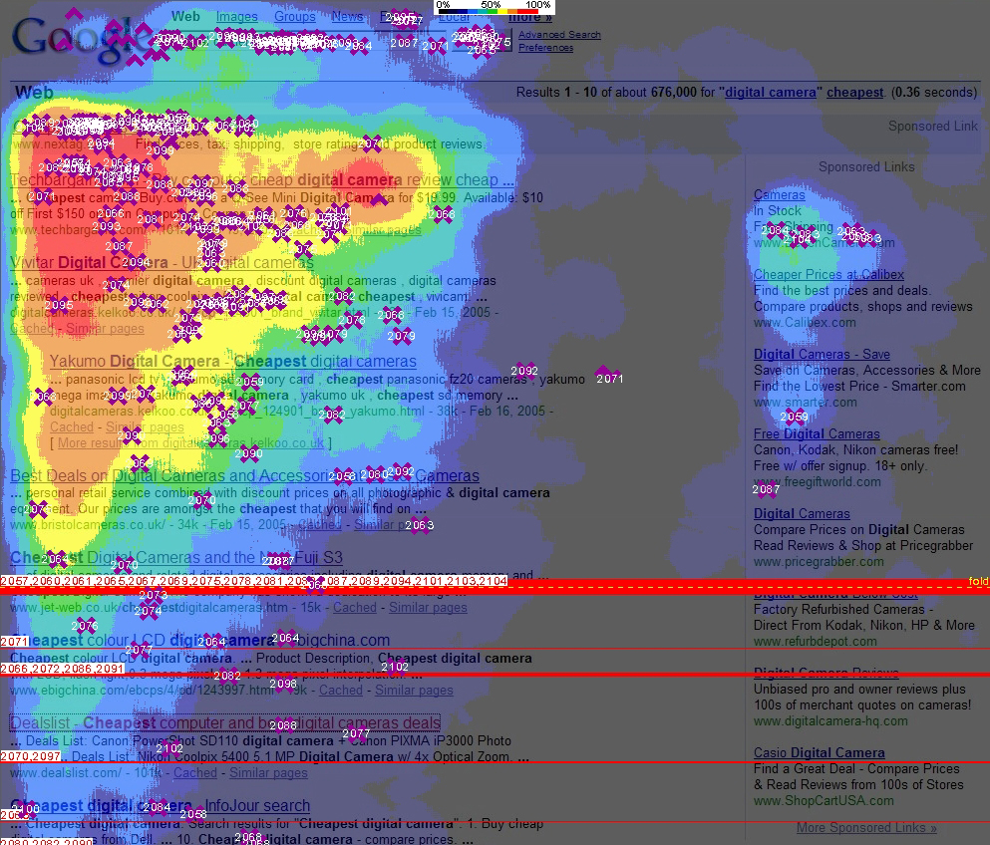
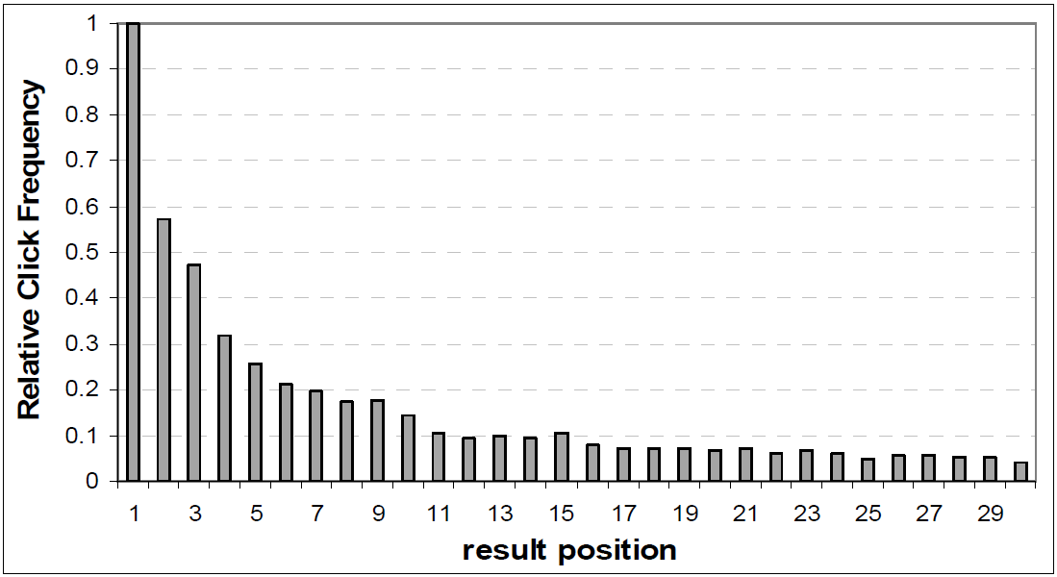
User Clicks Are Biased
Position-bias ^{[Joachims et al. SIGIR’05]}
  Higher position
  More clicks
  Not necessarily relevant
Modeling Clicks
=> Decompose relevance-driven clicks from position-driven clicks
[Lorigo, et al. J. Am. Soc. Inf. Sci., 2008]
[Agichtein et al. SIGIR'06]

Slide 4
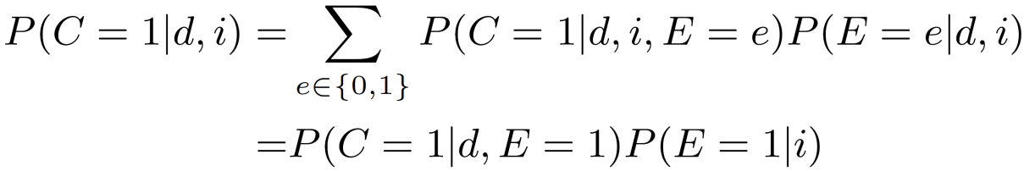
Modeling User Clicks
Decompose relevance-driven clicks from position-driven clicks
  Examine: user reads the displayed result
  Click: user clicks the displayed result
  Atomic unit: (query, doc)
Prob.
(q,d₁)
(q,d₂)
Relevance quality
Pos.
Click probability
Examine probability
(q,d₃)
(q,d₄)
Notes:
A user clicks on a returned document if and only if that document has been examined by the user and it is relevant to the given query.

Slide 5
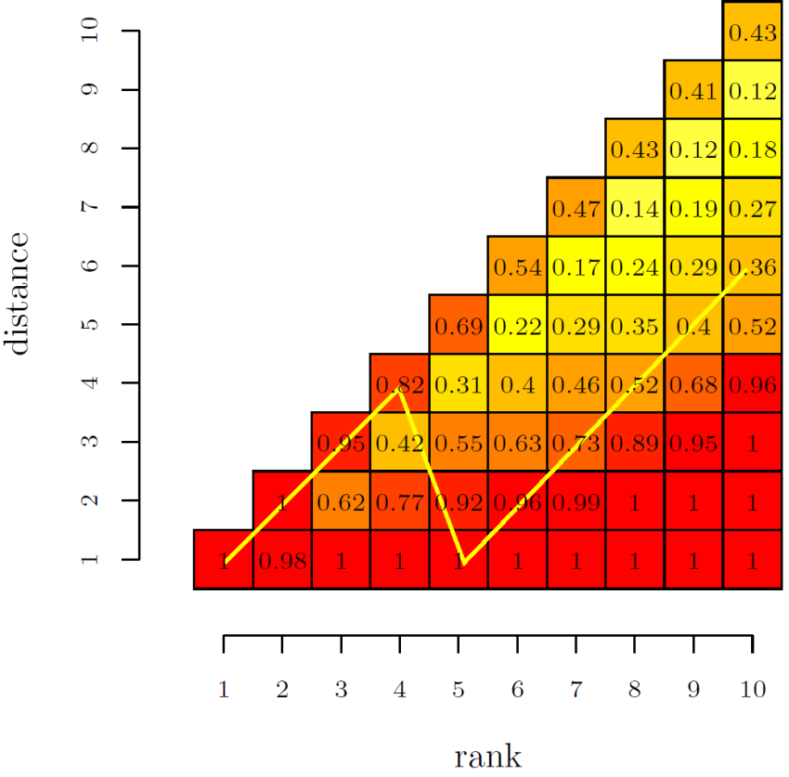
Modeling User Clicks
User Browsing Model ^{[Dupret et al. SIGIR’08]}
  Examination depends on distance to the last click
From absolute discount to relative discount

Slide 6
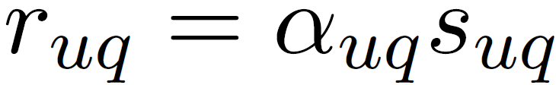
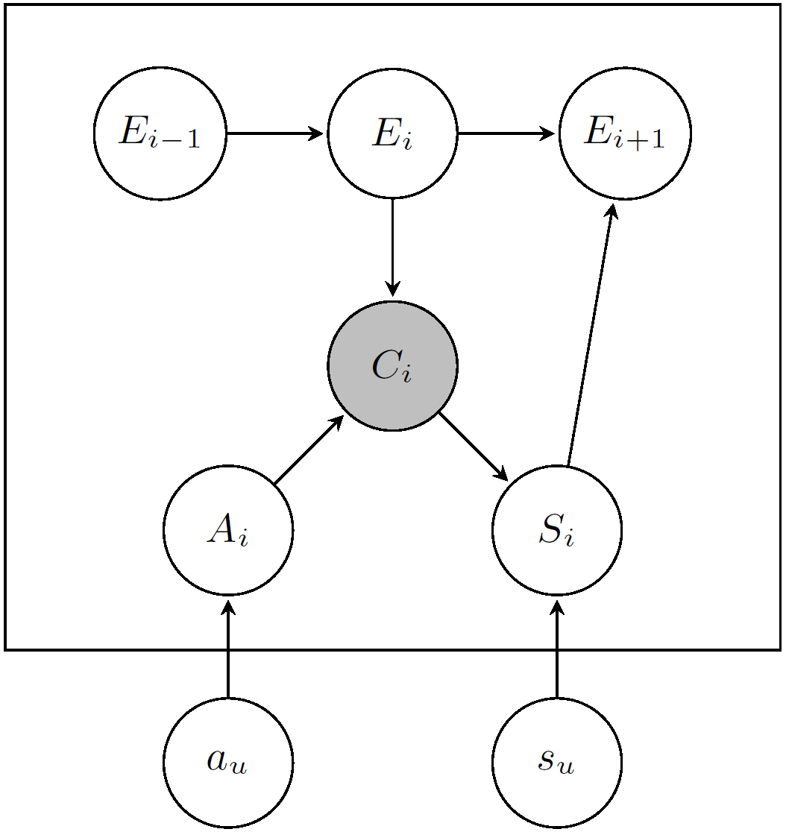
Modeling User Clicks
Dynamic Bayesian Model ^{[Chapelle et al. WWW’09]}
  A cascade model
  Relevance quality:
Examination chain
User’s satisfaction
Perceived relevance
Intrinsic relevance
Notes:
Cascade model assumes the user will examine the returned documents from top to bottom and make click decisions over each examined position sequentially.
Imposing stronger dependency assumption over the user’s click behaviors
Perceived relevance controls click and intrinsic relevance controls user’s satisfaction.

Slide 7
Limitation of Existing Work
Modeling relevance as an atomic parameter
  (query, doc) => relevance
  Information in document content is ignored
  Hard to generalize
Modeling relevance as an absolute quantity
  Fail to capture relative order

Slide 8
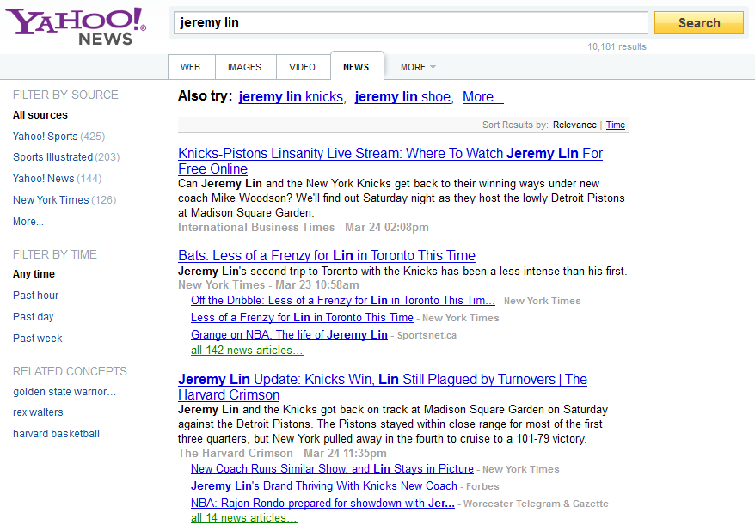

Revisit User Click Behaviors
Match my query?
Redundant doc?
Shall I move on?

Slide 9
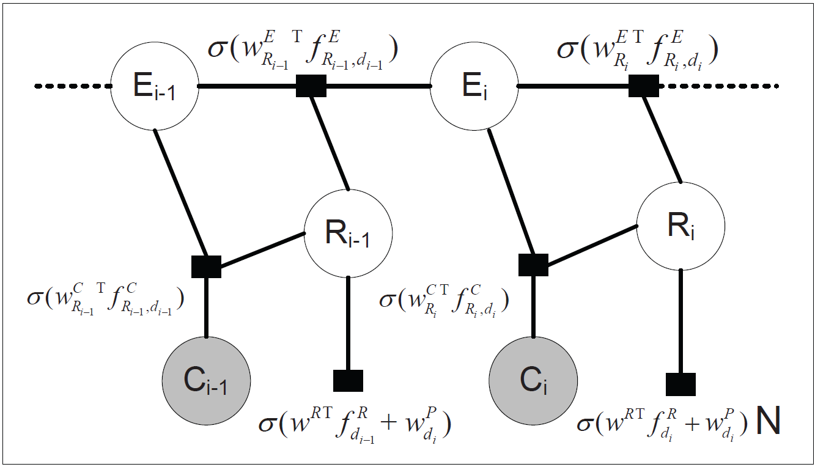
Content-Aware Click Modeling
Our Contribution
Encode dependency within user browsing behaviors via descriptive features
Chance to further examine the result documents: e.g., position, # clicks, distance to last click
Chance to click on an examined and relevant document: e.g., clicked/skipped content similarity
Relevance quality of a document: e.g., ranking features

Slide 10
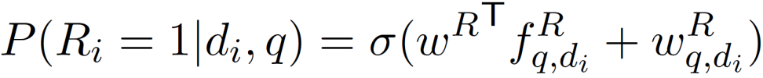
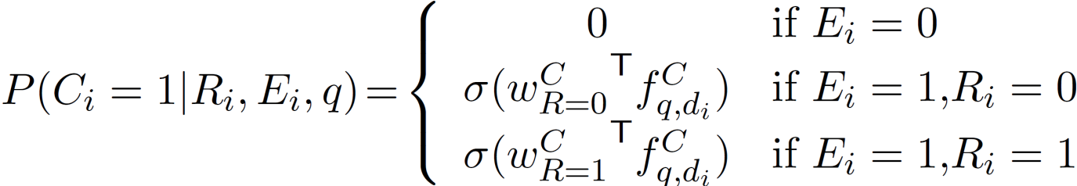
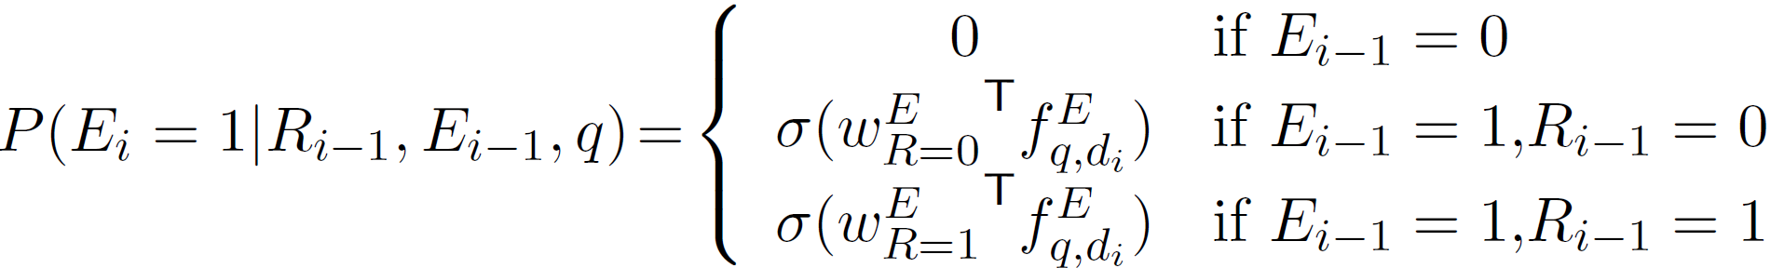
Content-Aware Click Modeling
Our Contribution
Conditional probability definition
  Relevance probability
  Click probability
  Examine probability

Slide 11
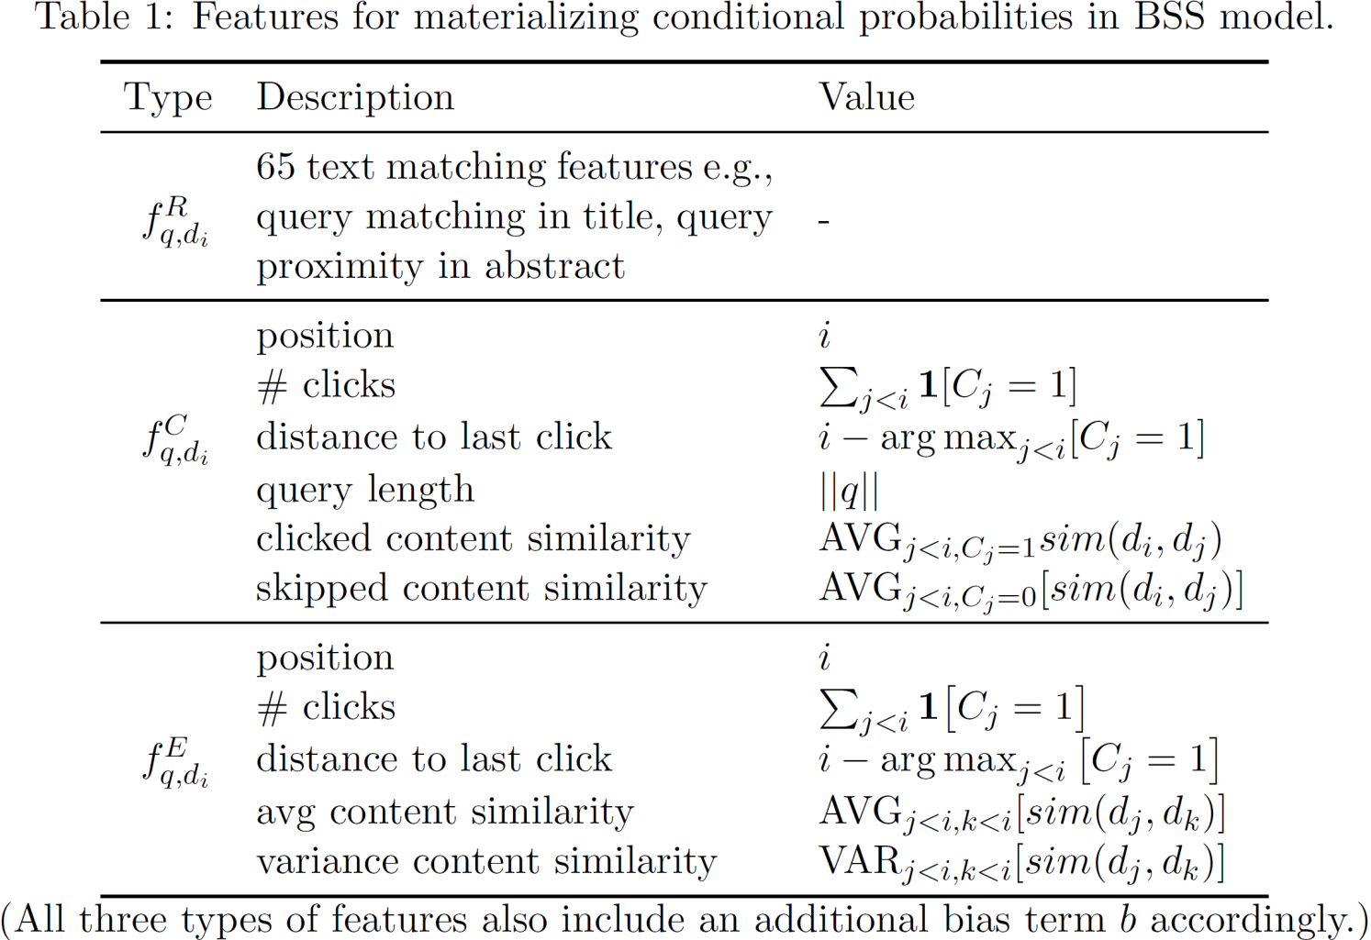
Content-Aware Click Modeling
Our Contribution
Feature definition for conditional probabilities

Slide 12
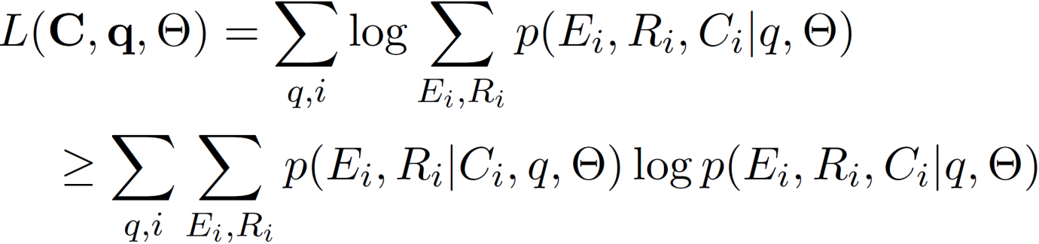
Content-Aware Click Modeling
Relevance estimation in BSS
Model estimation
  Expectation Maximization
E-Step: Posterior distribution of examine event and relevance quality
M-Step: Maximize the expectation of complete log-likelihood

Slide 13
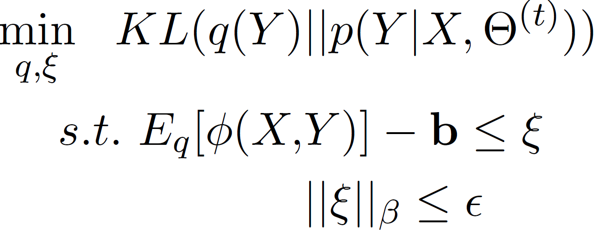
Posterior Regularization
Unidentifiable
Solution
  Posterior Regularized EM ^{[Graca et al. NIPS’07]}
Notes:
Deficiency: a document’s relevance status is exchangeable: since the click/examine events are determined by the same set of features, if we switch the labels of relevance status, the model can find another optimal weight setting by switching the original weight vectors for this two events but still maximizing the likelihood function

Slide 14
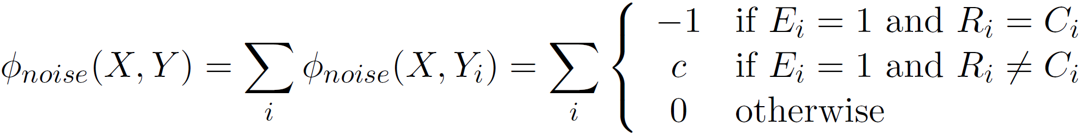
Posterior Constraints I
Dampen noisy clicks

Slide 15
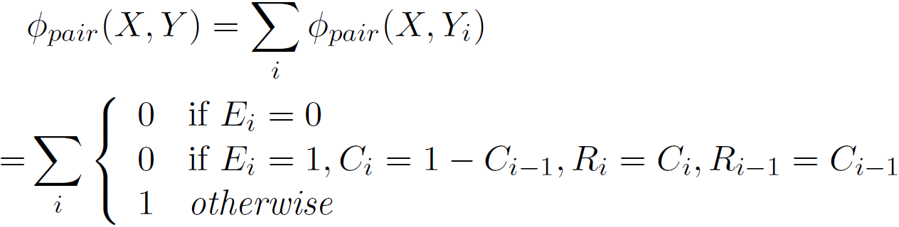
Posterior Constraints II
Reduce mis-ordered pairs
Penalize the inconsistent clicks

Slide 16
Experiments
Yahoo! News Search log
  May 2011 to July 2011
  Normal click set
    460k queries
  Random bucket click set
    Randomly shuffle top 4 positions – reduce position bias
    378k queries
  Editor’s annotation set
    Aug 9, 2011
    1.4k unique queries

Slide 17
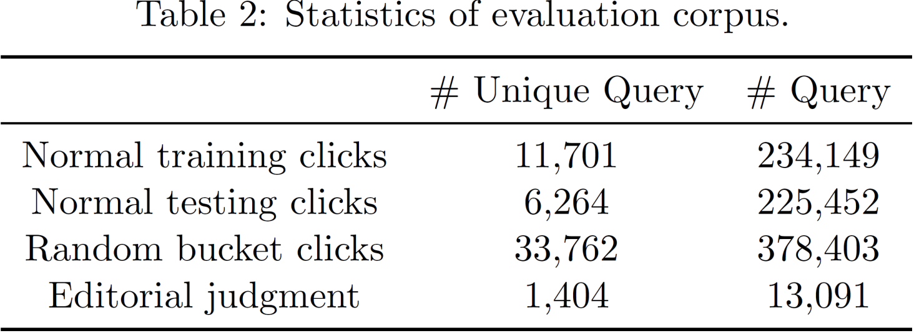
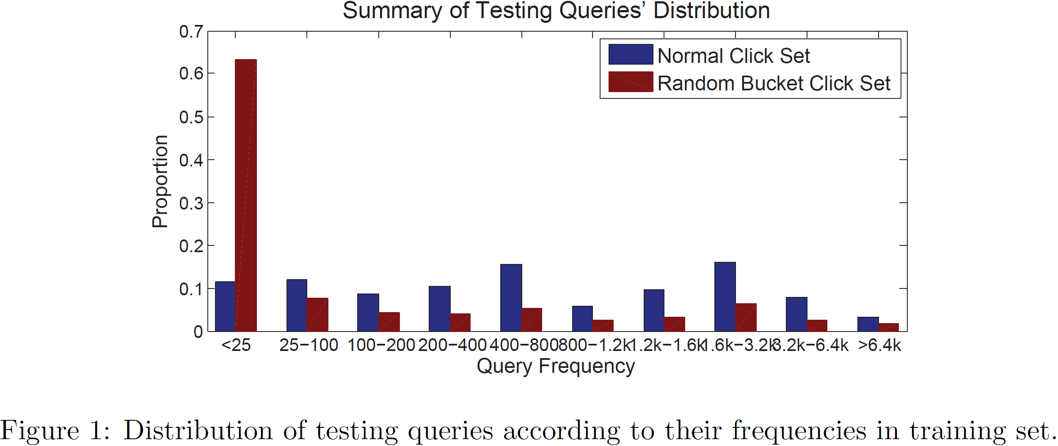
Data Sets
Evaluation set statistics

Slide 18
Quality of Relevance Modeling
Evaluation metrics
  Perplexity
    Distance between prediction and observation
  Deficiency
    Evaluated on positional-biased clicks
    Sensitive to the scale of prediction

Slide 19
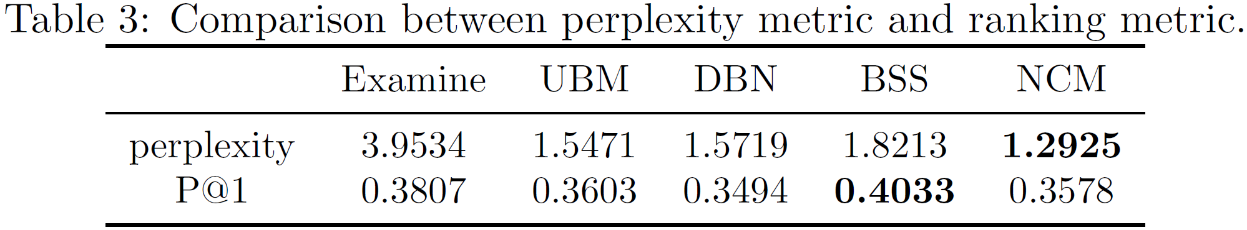
Quality of Relevance Modeling
Empirical analysis of perplexity
  Naïve Click Model (NCM)
    Click through rate => relevance
  Metrics
    Perplexity on normal test set
    P@1 on bucket test set – unbiased ^{[Li et al. WSDM’11]}

Slide 20
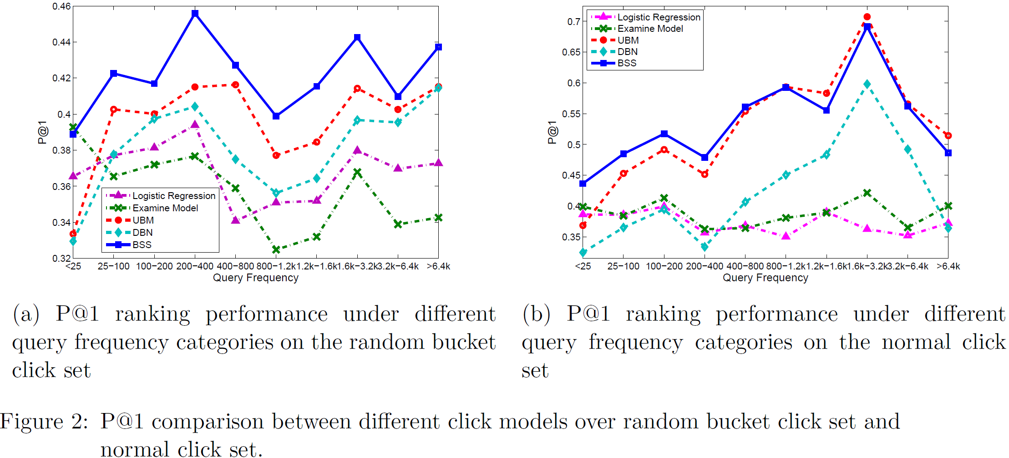
Quality of Relevance Modeling
Estimated relevance for ranking

Slide 21
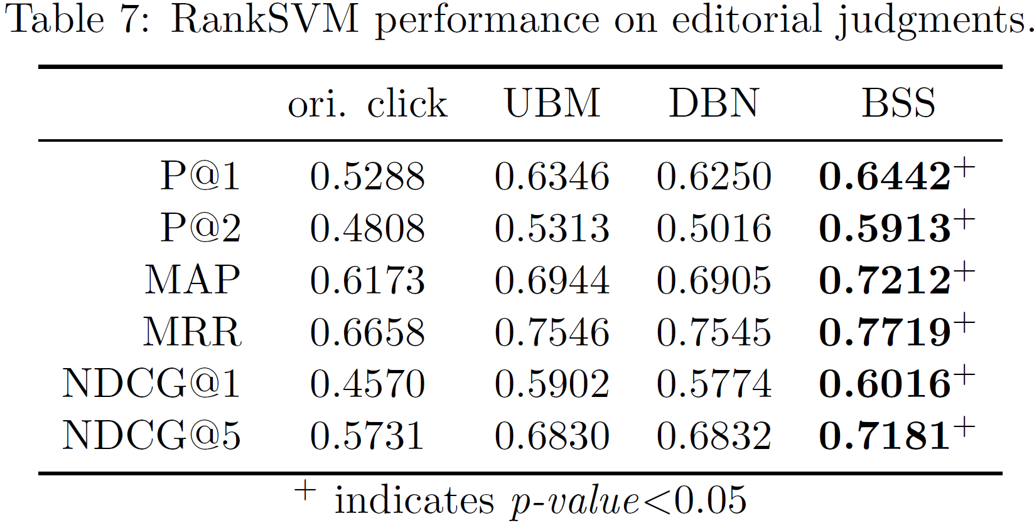
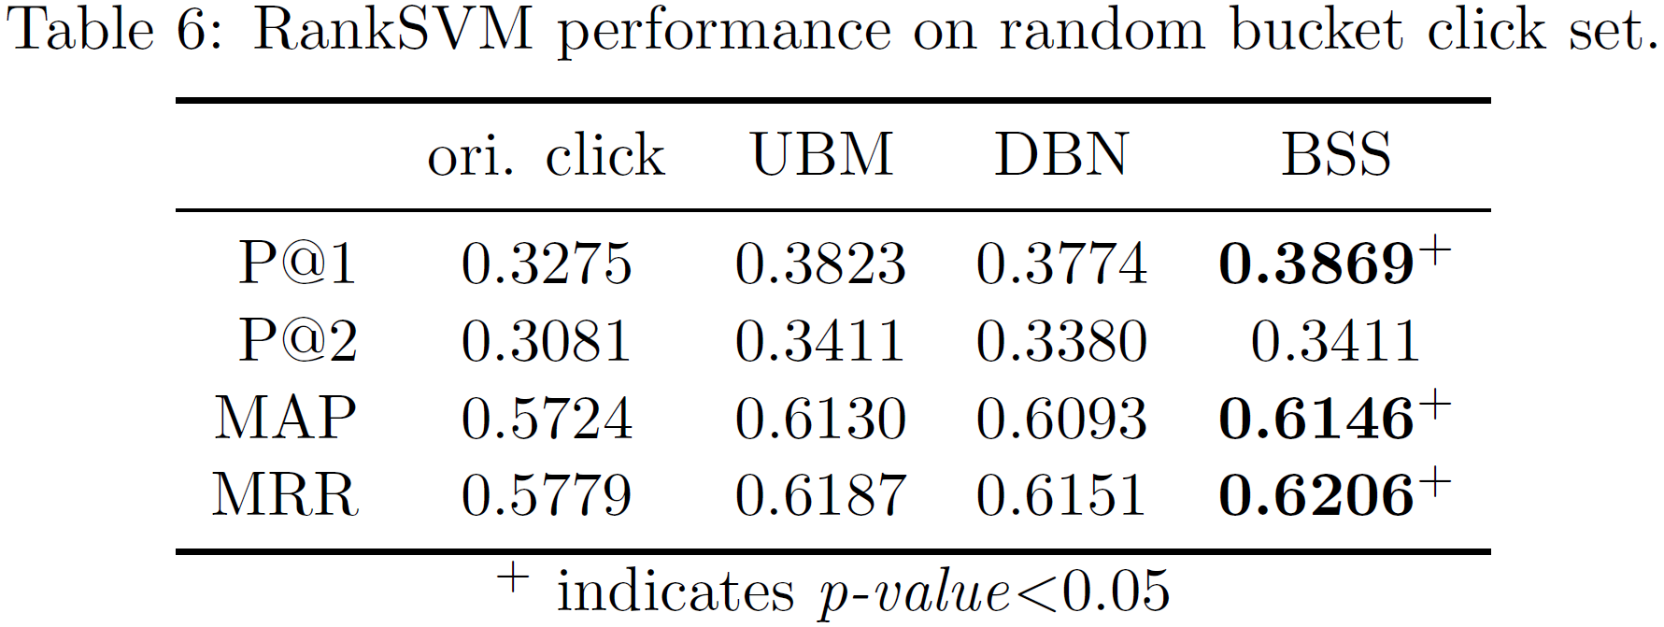
Quality of Relevance Modeling
Estimated relevance as signals for learning-to-rank training

Slide 22
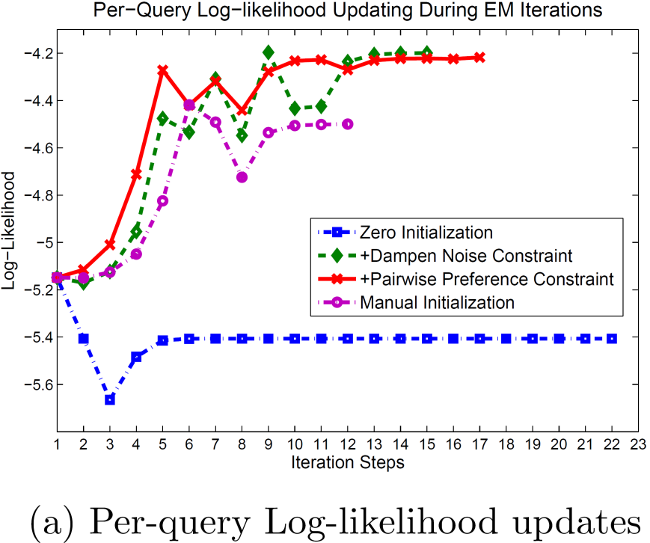
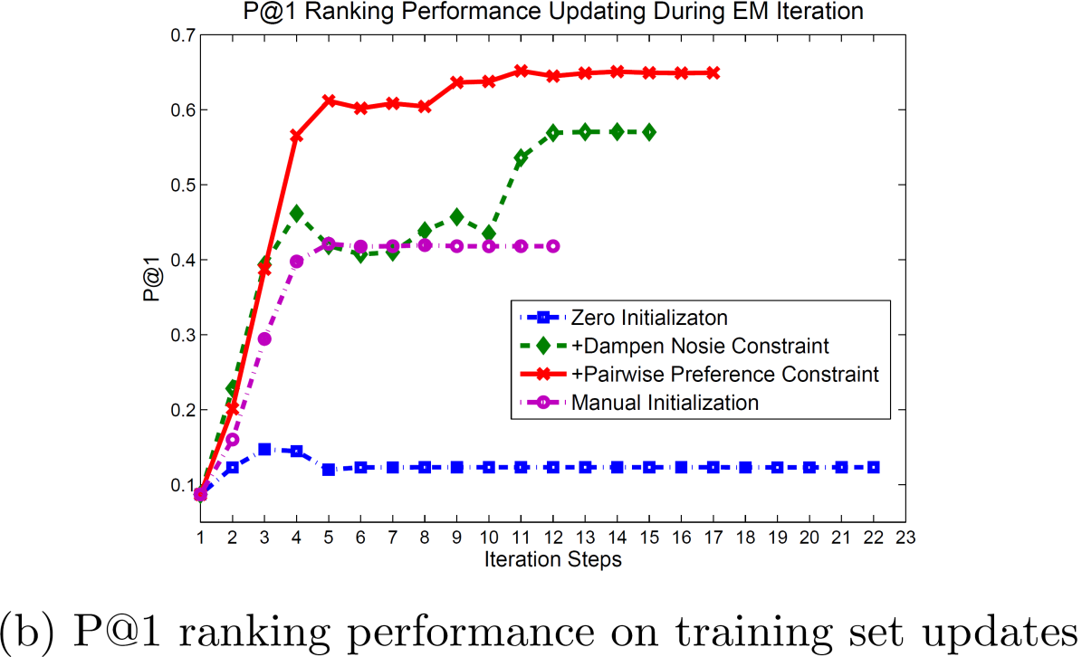
Effectiveness of Posterior Regularization
Posterior constraints

Slide 23
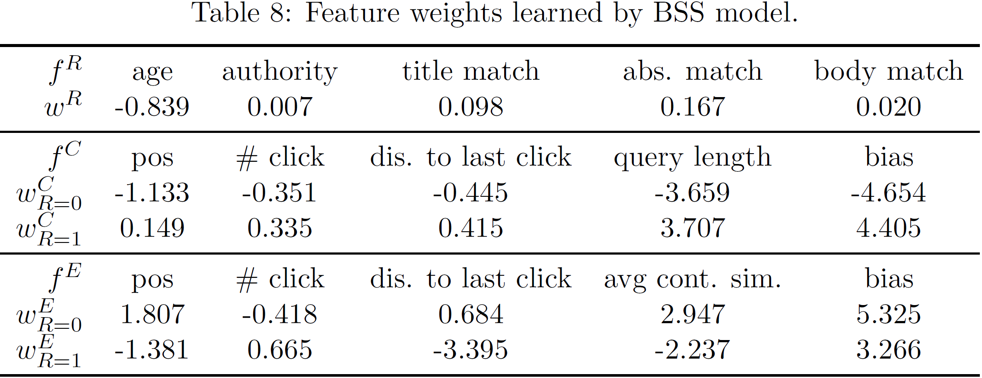
Understanding User Behaviors
Analyzing factors affecting user clicks

Slide 24
Conclusion & Future Work
Content-aware click modeling
  Utilize document content for modeling clicks
  Pairwise relevance modeling
Understanding user search behaviors
  Personalized click models
  Joint click modeling and learning-to-rank model estimation

Slide 25
References
comScore qSearchTM, http://www.comscore.com/Insights/Press_Releases/2012/4/comScore_Releases_March_2012_U.S._Search_Engine_Rankings
T. Joachims, L. Granka, B. Pan, H. Hembrooke, and G. Gay. Accurately interpreting clickthrough data as implicit feedback. SIGIR’05, pages 154–161. ACM.
E. Agichtein, E. Brill, S. Dumais, and R. Ragno. Learning user interaction models for predicting web search result preferences. SIGIG’06, pages 3–10. ACM.
M. Richardson, E. Dominowska, and R. Ragno. Predicting clicks: estimating the click-through rate for new ads. WWW’07, pages 521–530, ACM.
G. E. Dupret and B. Piwowarski. A user browsing model to predict search engine click data from past observations. SIGIR’08, pages 331–338, ACM.
O. Chapelle and Y. Zhang. A dynamic bayesian network click model for web search ranking. WWW’09, pages 1–10, ACM.
D. Koller and N. Friedman. Probabilistic graphical models: principles and techniques. The MIT Press, 2009.
J. Graca, K. Ganchev, and B. Taskar. Expectation maximization and posterior constraints. NIPS’07, 20:569–576.
L. Li, W. Chu, J. Langford, and X. Wang. Unbiased offline evaluation of contextual-bandit-based news article recommendation algorithms. WSDM'11, pages 297–306. ACM.

Slide 26
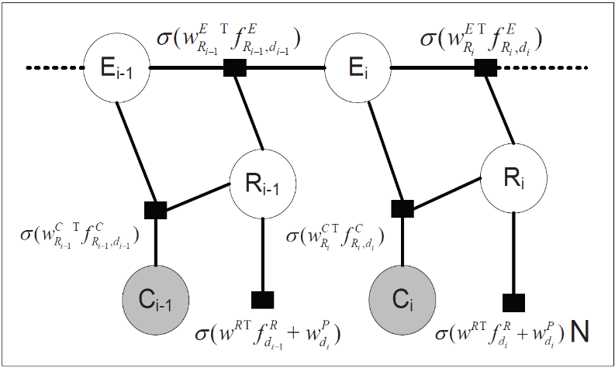

Content-Aware Click Modeling
Chance to further examine the result documents: e.g., position, # clicks, distance to last click
Chance to click on an examined and relevant document: e.g., clicked/skipped content similarity
Relevance quality of a document: e.g., ranking features
Thank you!
  Q&A

Slide 27
Content-Aware Click Modeling
Our Contribution
A generative story for Bayesian Sequential State Model
1. whether to examine current position
2. relevance quality of current document
3. whether to click the examined document

Slide 28
Content-Aware Click Modeling
Posterior Inference
  Exact inference is feasible
  Belief propagation ^{[Koller and Friedman, 2009]}

Slide 29
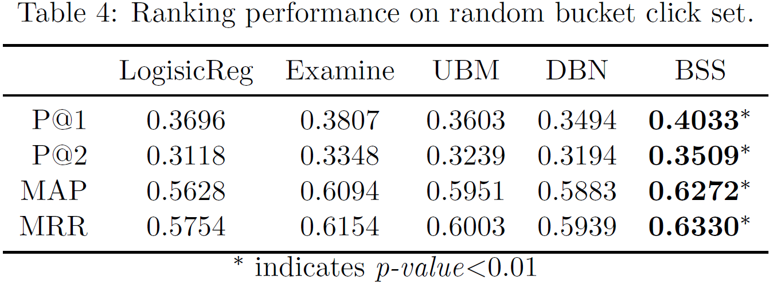
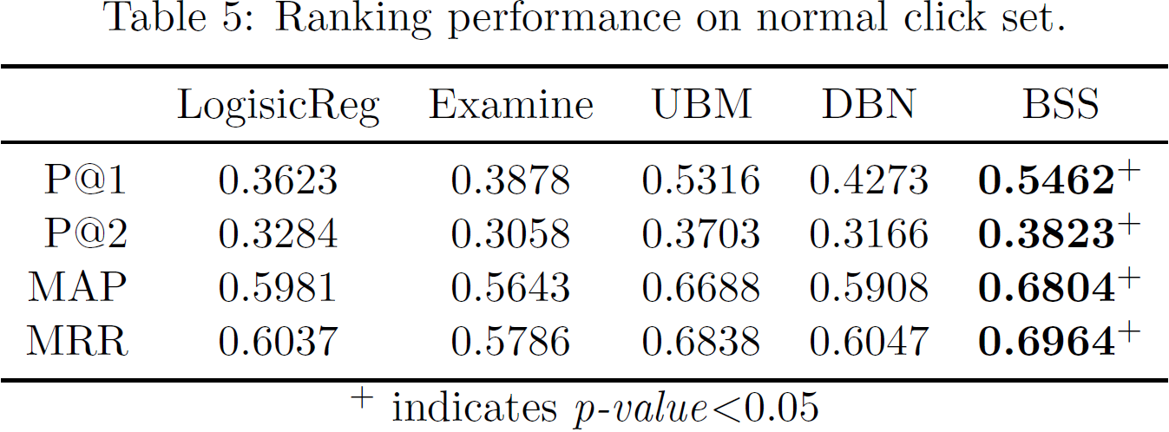
Quality of Relevance Modeling
Estimated relevance for ranking

Slide 30
Summary of Solution
Our Contribution
Introduce rich dependency within user browsing behaviors via descriptive features
Chance to further examine the result documents: e.g., position, # clicks, distance to last click
Chance to click on an examined and relevant document: e.g., clicked/skipped content similarity
Relevance quality of a document: e.g., ranking features

